Slide 1
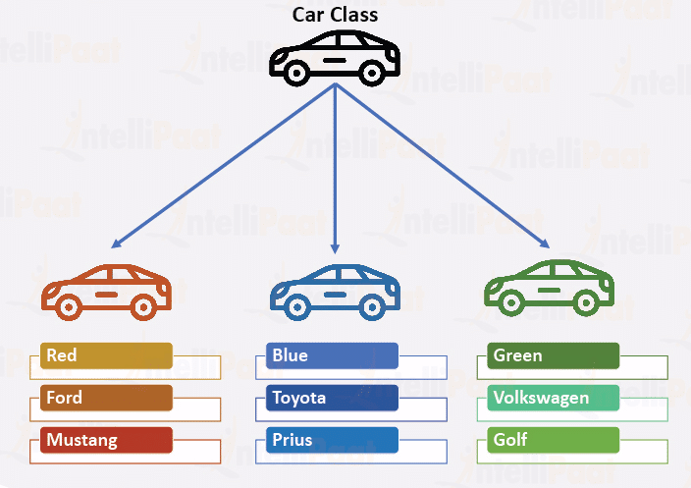
Python Advanced Python classes
Module - 2
Presentation By
Mohammed Tahir Mirji
MTech CS

Slide 2
CONTENTS
Python OOPs Concepts
Class
Objects
Polymorphism
Encapsulation
Inheritance
Data Abstraction
Create Objects using Python Classes
Assignments
Code Examples Github Link

Slide 3
Python OOPs Concepts
In Python, object-oriented Programming (OOPs) is a programming paradigm that uses objects and classes in programming. It aims to implement real-world entities like inheritance, polymorphisms, encapsulation, etc. in the programming.
The main concept of OOPs is to bind the data and the functions that work on that together as a single unit so that no other part of the code can access this data.

Slide 4
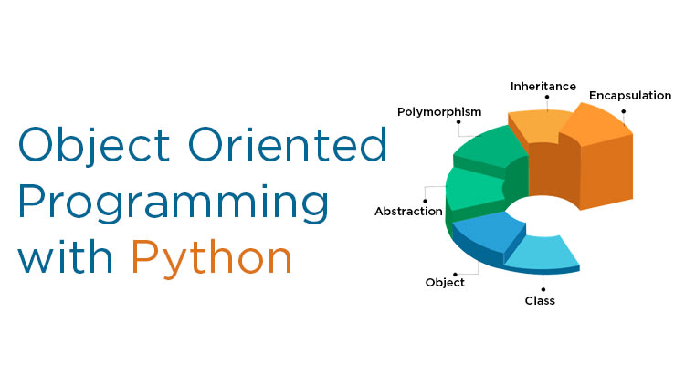
Main Concepts of Object-Oriented Programming (OOPs)
Class
Objects
Polymorphism
Encapsulation
Inheritance
Data Abstraction

Slide 5
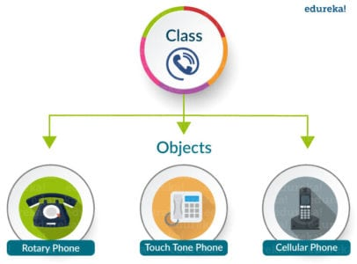
Class
A class is a collection of objects. A class contains the blueprints or the prototype from which the objects are being created. It is a logical entity that contains some attributes and methods.

Slide 6
Class
Some points on Python class:
Classes are created by keyword class.
Attributes are the variables that belong to a class.
Attributes are always public and can be accessed using the dot (.) operator. Eg.: Myclass.Myattribute
Class Definition Syntax:
class ClassName:
# Statement-1
.
.
.
# Statement-N

Slide 7
Class- Creating an empty Class in Python
We have created a class named dog using the class keyword.
# Python3 program to
# demonstrate defining
# a class
class Dog:
a=0

Slide 8
Objects
An Object is an instance of a Class. A class is like a blueprint while an instance is a copy of the class with actual values.
An object consists of :
State: It is represented by the attributes of an object. It also reflects the properties of an object.
Behavior: It is represented by the methods of an object. It also reflects the response of an object to other objects.
Identity: It gives a unique name to an object and enables one object to interact with other objects.

Slide 9
Objects - Declaring Objects (Also called instantiating a class)
class Dog:
# attribute
attr1 = "mammal"
attr2 = "dog"
# A sample method
def fun(self):
print("I'm a", self.attr1)
print("I'm a", self.attr2)
# Object instantiation
Rodger = Dog()
# Accessing class attributes
# and method through objects
print(Rodger.attr1)
Rodger.fun()
When an object of a class is created, the class is said to be instantiated. All the instances share the attributes and the behavior of the class. But the values of those attributes, i.e. the state are unique for each object. A single class may have any number of instances.

Slide 10
Polymorphism
Polymorphism simply means having many forms. For example, we need to determine if the given species of birds fly or not, using polymorphism we can do this using a single function.
class ostrich(Bird):
def flight(self):
print("Ostriches cannot fly.")
obj_bird = Bird()
obj_spr = sparrow()
obj_ost = ostrich()
obj_bird.intro()
obj_bird.flight()
obj_spr.intro()
obj_spr.flight()
obj_ost.intro()
obj_ost.flight()
class Bird:
def intro(self):
print("There are many types of birds.")
def flight(self):
print("Most of the birds can fly but some cannot.")
class sparrow(Bird):
def flight(self):
print("Sparrows can fly.")

Slide 11
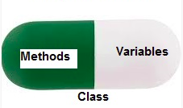
Encapsulation
Encapsulation is one of the fundamental concepts in object-oriented programming (OOP).
It describes the idea of wrapping data and the methods that work on data within one unit. This puts restrictions on accessing variables and methods directly and can prevent the accidental modification of data.
To prevent accidental change, an object’s variable can only be changed by an object’s method. Those types of variables are known as private variables.
A class is an example of encapsulation as it encapsulates all the data that is member functions, variables, etc.

Slide 12
Encapsulation - Encapsulation in Python
# Creating a Base class
class Base:
def __init__(self):
self.a = “Python World"
self.__c = " Python World "
# Creating a derived class
class Derived(Base):
def __init__(self):
# Calling constructor of
# Base class
Base.__init__(self)
print("Calling private member of base class: ")
print(self.__c)
# Driver code
obj1 = Base()
print(obj1.a)

Slide 13
Inheritance
Inheritance is the capability of one class to derive or inherit the properties from another class. The class that derives properties is called the derived class or child class and the class from which the properties are being derived is called the base class or parent class. The benefits of inheritance are:
It represents real-world relationships well.
It provides the reusability of a code. We don’t have to write the same code again and again. Also, it allows us to add more features to a class without modifying it.
It is transitive in nature, which means that if class B inherits from another class A, then all the subclasses of B would automatically inherit from class A.

Slide 14
Inheritance
Types of Inheritance –
Single Inheritance: Single-level inheritance enables a derived class to inherit characteristics from a single-parent class.
Multilevel Inheritance: Multi-level inheritance enables a derived class to inherit properties from an immediate parent class which in turn inherits properties from his parent class.
Hierarchical Inheritance: Hierarchical level inheritance enables more than one derived class to inherit properties from a parent class.
Multiple Inheritance: Multiple level inheritance enables one derived class to inherit properties from more than one base class.

Slide 15
Data Abstraction
It hides the unnecessary code details from the user. Also, when we do not want to give out sensitive parts of our code implementation and this is where data abstraction came.
Data Abstraction in Python can be achieved through creating abstract classes.

Slide 16
Create Objects using Python Classes
Declaring Objects (Also called instantiating a class)
When an object of a class is created, the class is said to be instantiated. All the instances share the attributes and the behavior of the class. But the values of those attributes, i.e. the state are unique for each object. A single class may have any number of instances.
class Dog:
# A simple class
# attribute
attr1 = "mammal"
attr2 = "dog"
# A sample method
def fun(self):
print("I'm a", self.attr1)
print("I'm a", self.attr2)
# Object instantiation
Rodger = Dog()
# Accessing class attributes
# and method through objects
print(Rodger.attr1)
Rodger.fun()

Slide 17
Assignments
Create 5 classes of engineers with their attributes with job descriptions using inheritance.

Slide 18
Code for the presentation can be found here
Refer Readme.md of github repository for list of assignments:
https://github.com/tahirmirji/ai_with_python_keonics

Slide 19
Thank You

